Slide 1
Sandboxing .NET Assemblies for fun, profit and, of course Security!
Niels Tanis
NDC { London }

Slide 2

Who am I?
Niels Tanis
Sr. Principal Security Researcher @ Veracode
Background .NET Development, Pentesting/ethical hacking, and software security consultancy
Research on static analysis for .NET apps

Slide 3
Agenda
Introduction
The security risks of third party libraries
Sandboxing techniques
Let’s create a sandbox!
Conclusion
QA

Slide 4
Third Party Libraries
Big chunk (80%+) of our apps consists of 3rd party libraries
Efficient in time, why reinvent the wheel?
How actively is it maintained?
What do they do for security?

Slide 5

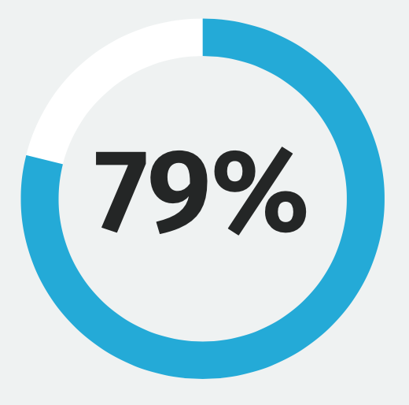
State Of Software Security v11 2021
”Despite this dynamic landscape, 79 percent of the time, developers never update third-party libraries after including them in a codebase.”
Notes:
https://info.veracode.com/fy22-state-of-software-security-v11-open-source-edition.html

Slide 6
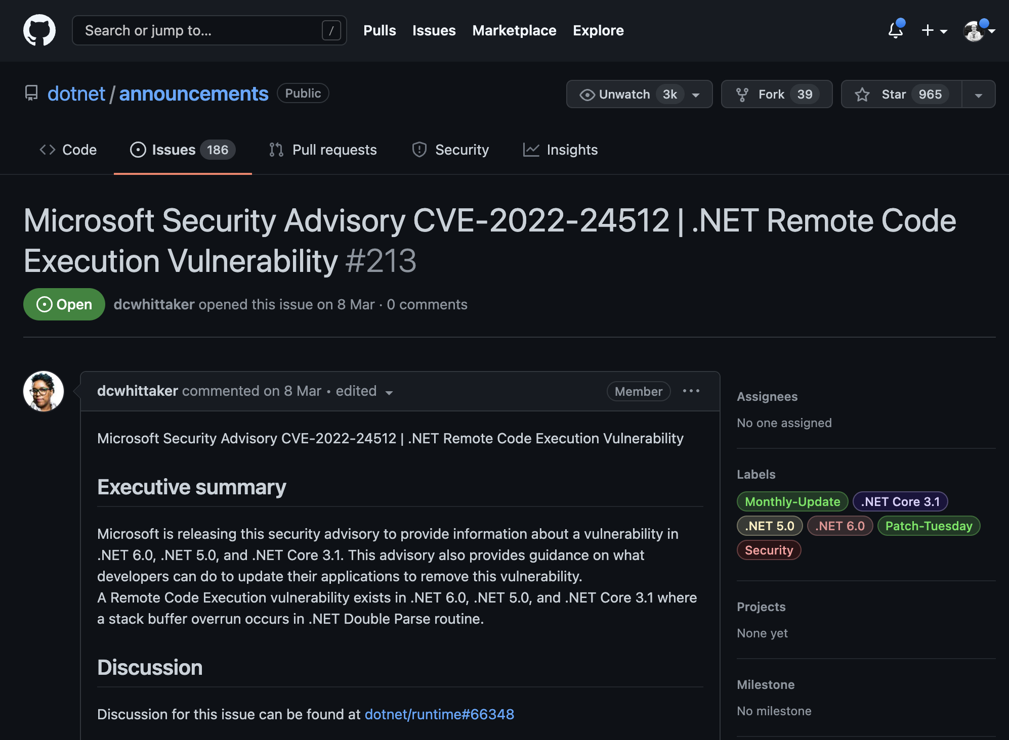
Vulnerabilities in libraries
Notes:
https://github.com/dotnet/announcements/issues/213

Slide 7
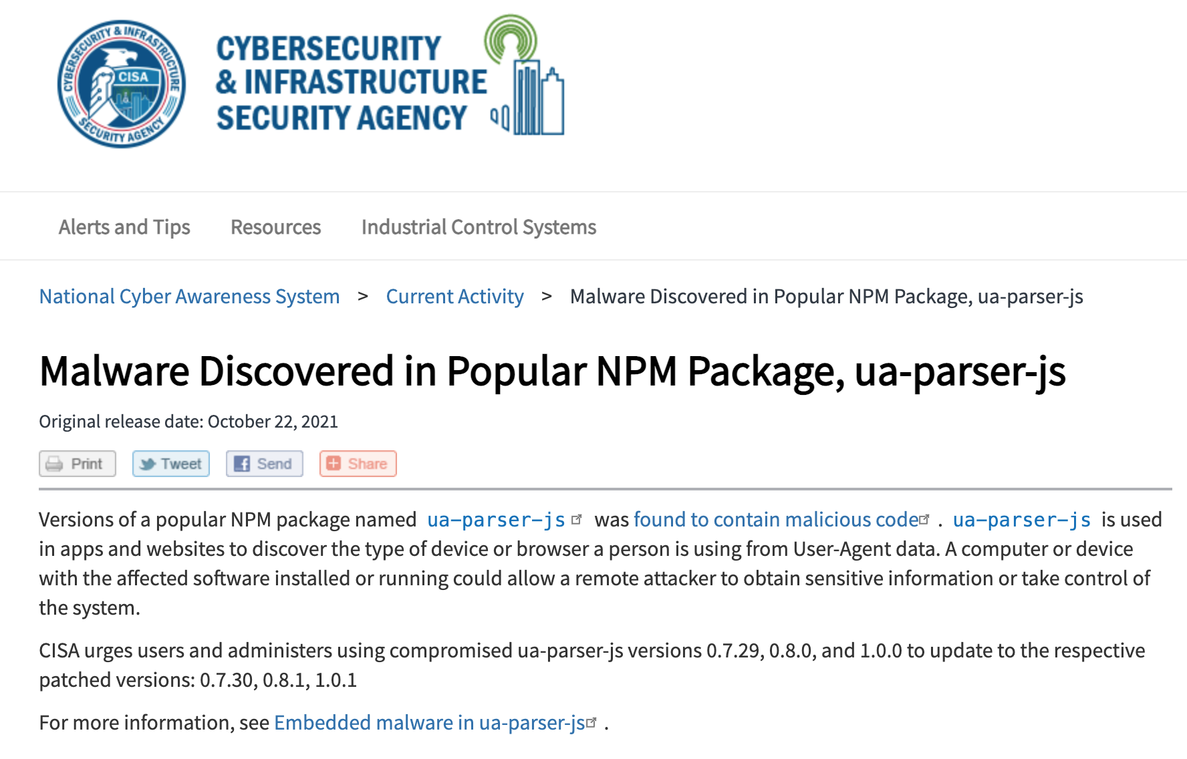
Vulnerabilities in libraries
Notes:
https://us-cert.cisa.gov/ncas/current-activity/2021/10/22/malware-discovered-popular-npm-package-ua-parser-js
https://portswigger.net/daily-swig/popular-npm-package-ua-parser-js-poisoned-with-cryptomining-password-stealing-malware

Slide 8
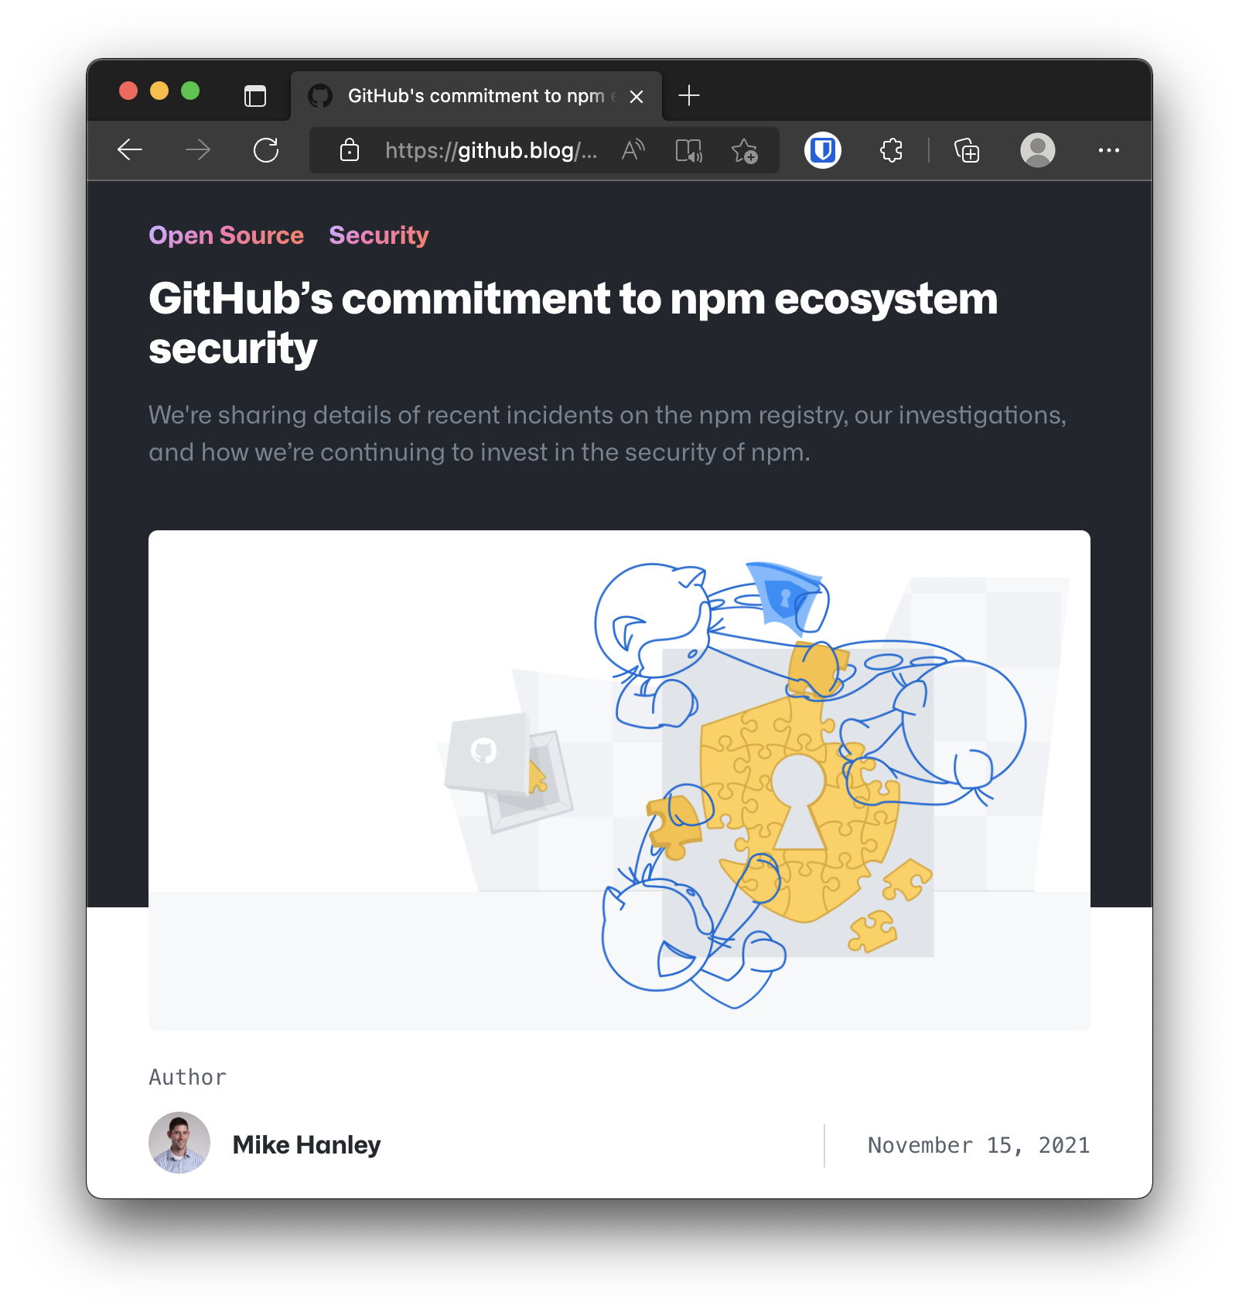
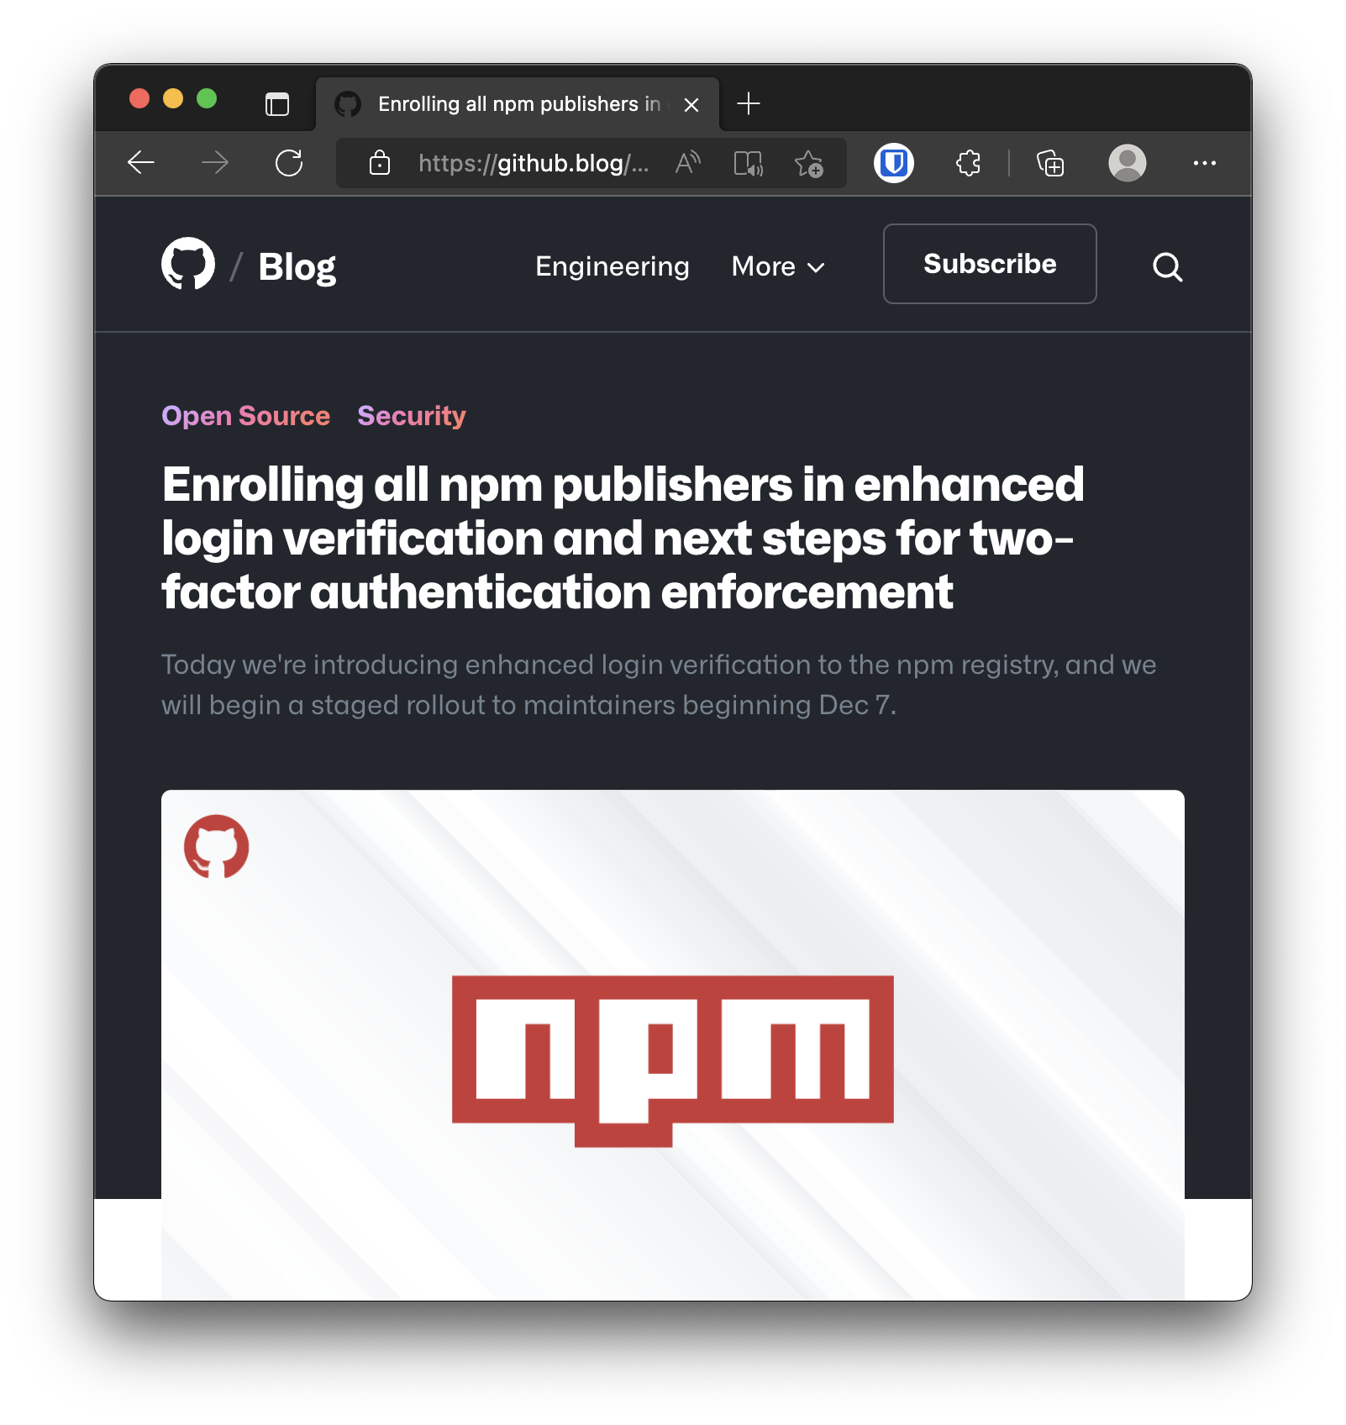
Vulnerabilities in libraries
Notes:
https://github.blog/2021-11-15-githubs-commitment-to-npm-ecosystem-security/
https://github.blog/2021-12-07-enrolling-npm-publishers-enhanced-login-verification-two-factor-authentication-enforcement/

Slide 9
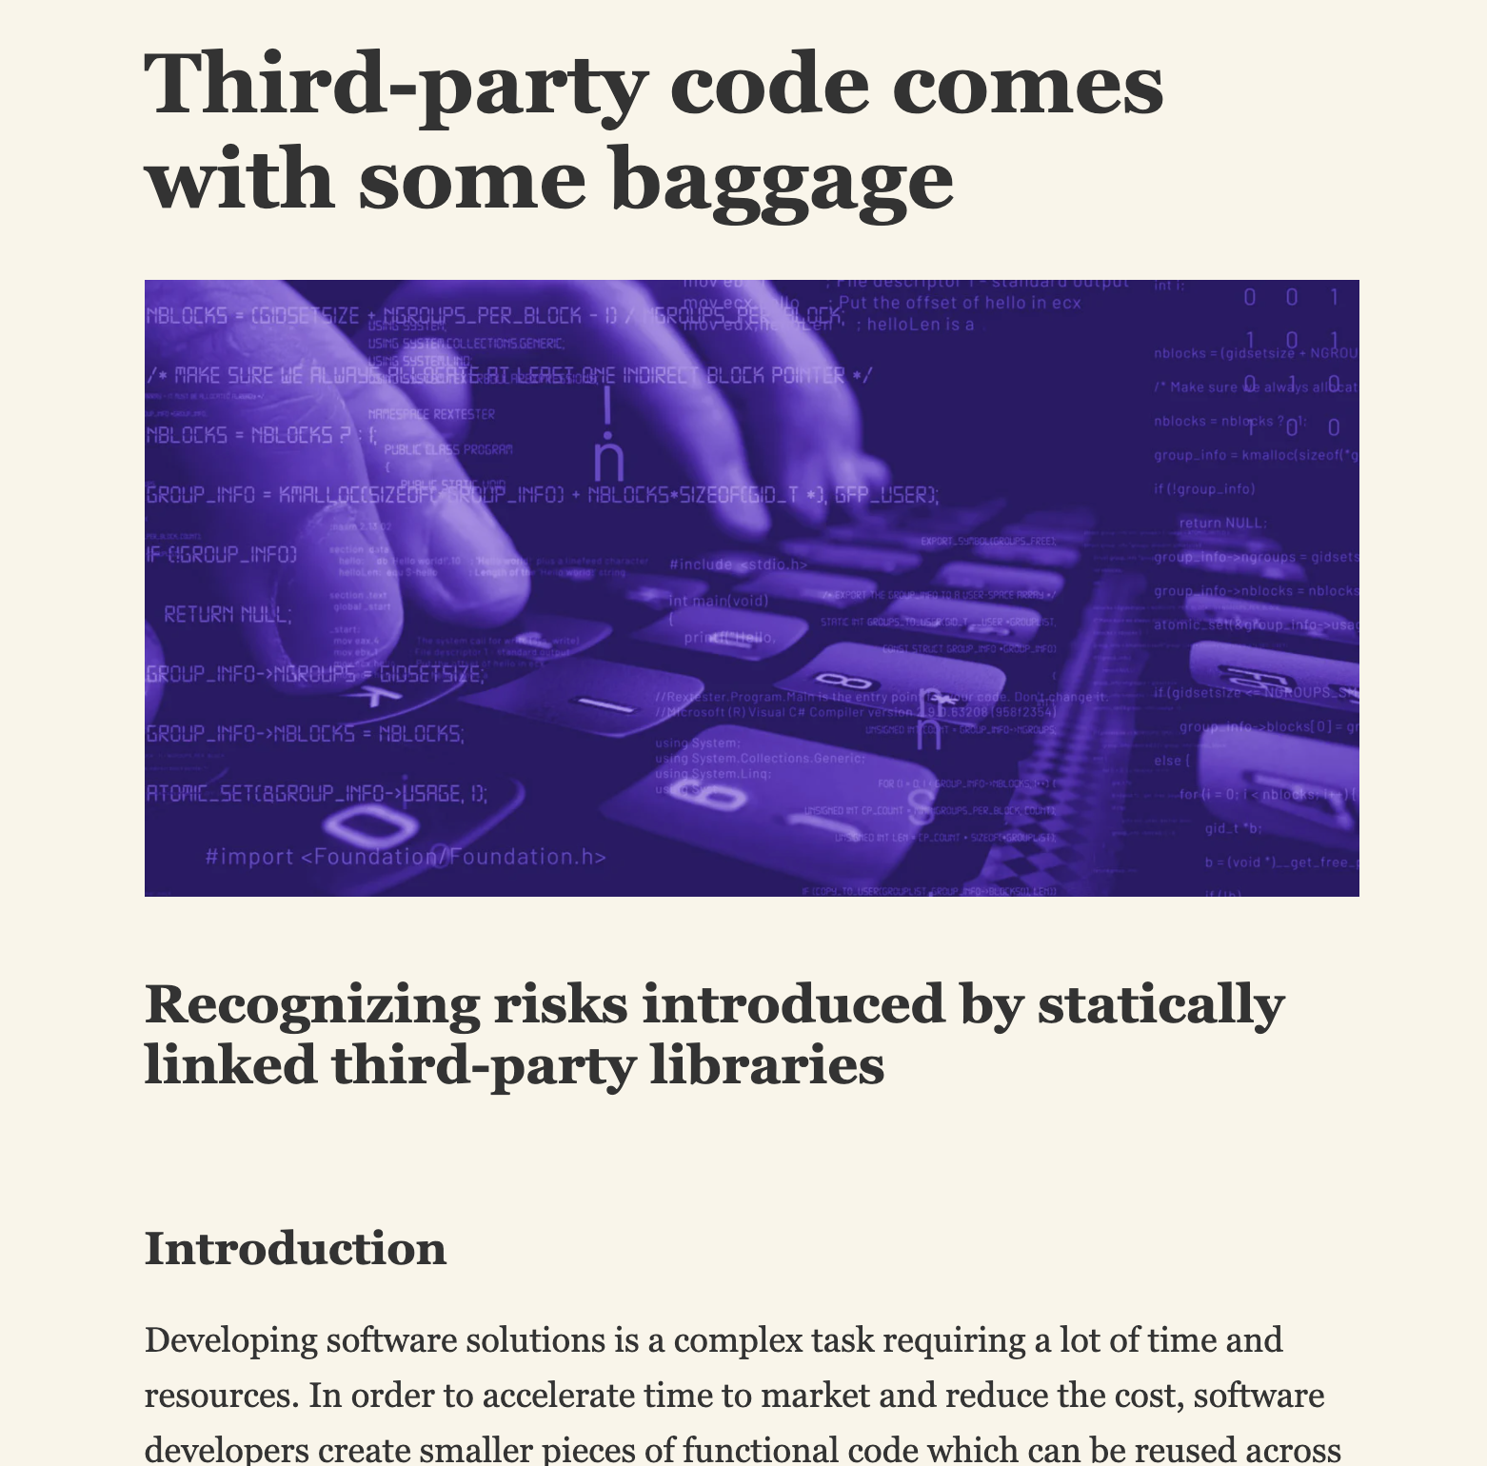
Vulnerabilities in libraries
Notes:
https://blog.secure.software/third-party-code-comes-with-some-baggage

Slide 10
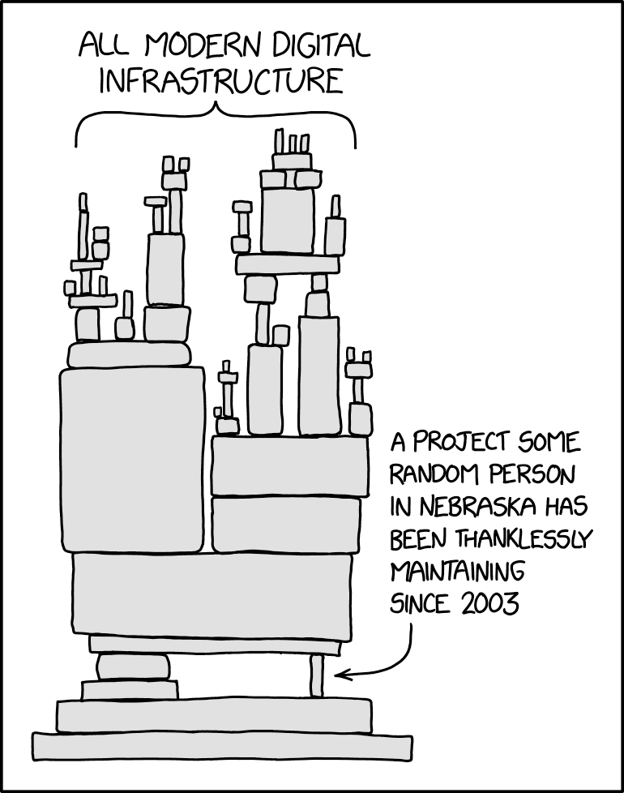
XKDC - Dependency
https://xkcd.com/2347/

Slide 11
Sandboxing .NET Assemblies
Is there a way we can do a better job?
A way for us to reduce the security risks?
Keep in mind it’s not a matter of how it’s more when!

Slide 12
Sandboxing .NET Assemblies
We want to use the library without modification
Can we maybe create a controlled (restricted) sandbox?
A sandbox with limited capabilities?

Slide 13
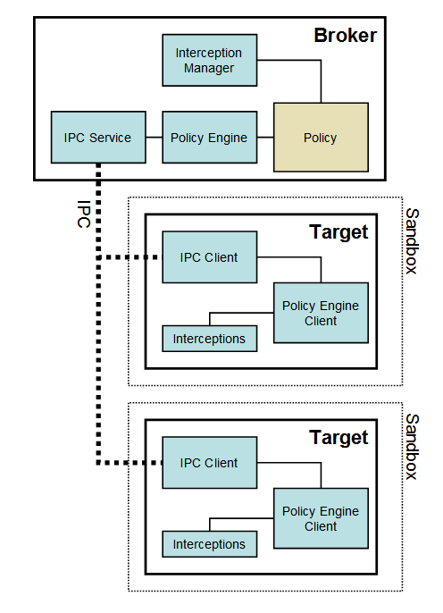
Browser Sandbox
Chromium Sandbox
No direct system access
Each OS related call is done via IPC
FireFox Sandbox
Containers & Site Isolation
RLBox
Notes:
https://chromium.googlesource.com/chromium/src/+/refs/heads/main/docs/design/sandbox.md
https://hacks.mozilla.org/2021/05/introducing-firefox-new-site-isolation-security-architecture/

Slide 14
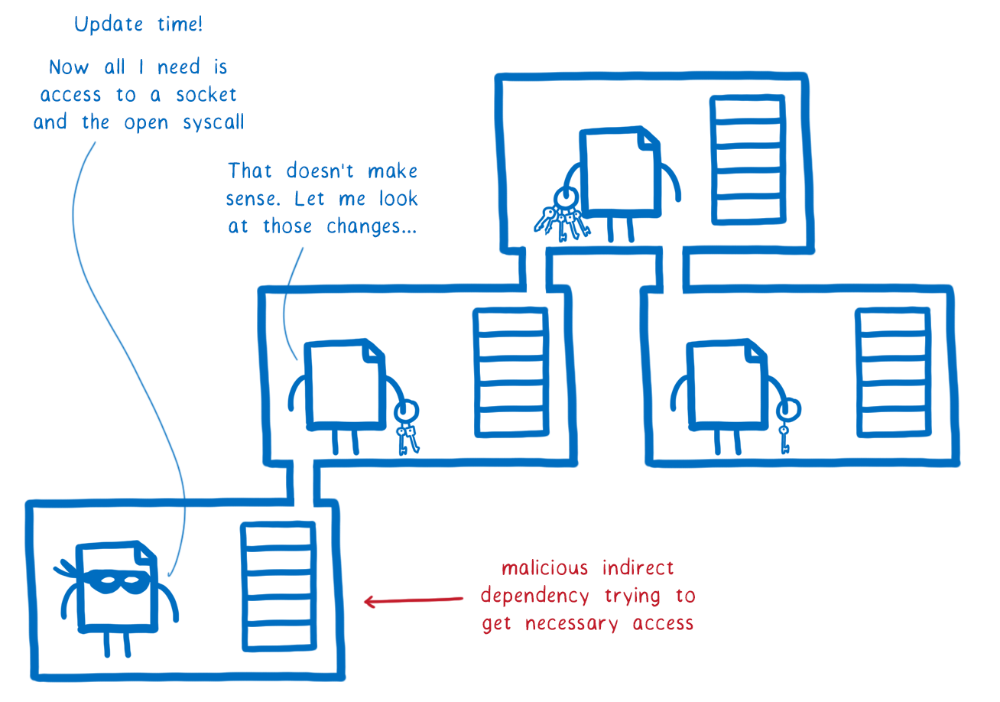
WebAssembly Nanoprocess
Lineair memory model
Control-Flow integrity
WASM module isolation
Declaritive permissions
Interface types
WASI for BCL calls
Notes:
https://hacks.mozilla.org/2019/11/announcing-the-bytecode-alliance/

Slide 15
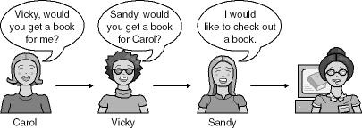
Code Access Security
Evidence based model
Code from different origins have different sets of rights
Stack-walks that protect against luring attacks
Notes:
Figure 18-1; Writing Secure Code 2nd Edition

Slide 16
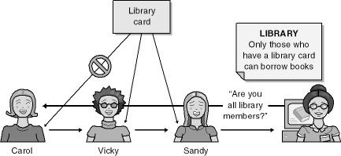
Code Access Security
Evidence library card
Policy → Librarian only allows members
Notes:
Figure 18-2; Writing Secure Code 2nd Edition

Slide 17
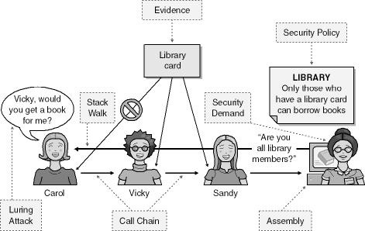
Code Access Security
Stack walk
Notes:
Figure 18-2; Writing Secure Code 2nd Edition

Slide 18
Code Access Security
Most practical example, ASP.NET Medium Trust
CAS is deprecated since .NET Framework 4
Flipping a mutex in user memory to disable
Too complex in administering and use?
Too early?
Notes:
https://docs.microsoft.com/en-us/previous-versions/dotnet/framework/code-access-security/code-access-security-basics
https://docs.microsoft.com/en-us/previous-versions/dotnet/framework/code-access-security/code-access-security-policy-compatibility-and-migration

Slide 19


Demo time!
Notes:
Image: C# logo https://docs.microsoft.com/en-us/dotnet/csharp/

Slide 20
DocumentProcessor Package
Use package as is!
Disclaimer: always comply with library license!
Not allowed to reverse engineer/decompile
We do want to change behaviour:
Opening documents directly from URL – SSRF
Writing files to any arbitrary directory – Path Traversal
There are several ways to fix this!

Slide 21
AssemblyLoadContext
Only single AppDomain in .NET Core.
AssemblyLoadContext replaces the isolation mechanisms provided by multiple AppDomain instances in .NET Framework.
Conceptually, a load context creates a scope for loading, resolving, and potentially unloading a set of assemblies.
Notes:
https://docs.microsoft.com/en-us/dotnet/api/system.runtime.loader.assemblyloadcontext?view=net-5.0
https://docs.microsoft.com/en-us/dotnet/core/dependency-loading/understanding-assemblyloadcontext

Slide 22
AssemblyLoadContext
It allows multiple versions of the same assembly to be loaded within a single process.
It does not provide any security features. All code has full permissions of the process.
But it does allow us to control what gets loaded!
Notes:
https://docs.microsoft.com/en-us/dotnet/api/system.runtime.loader.assemblyloadcontext?view=net-5.0
https://docs.microsoft.com/en-us/dotnet/core/dependency-loading/understanding-assemblyloadcontext

Slide 23
AssemblyLoadContext
Interface project used as shared contract
Remove DocumentProcessor package from ConsoleApp
Add reference to interface project
Create Library that implements interface
Reference interface project and DocumentProcessor Package
Self-contained deployment to folder that has all to be loaded by our sandboxed loadcontext
Notes:
https://docs.microsoft.com/en-us/dotnet/api/system.runtime.loader.assemblyloadcontext?view=net-5.0
https://docs.microsoft.com/en-us/dotnet/core/dependency-loading/understanding-assemblyloadcontext

Slide 24
Sandboxing DocumentProcessor
Notes:
Image: C# logo https://docs.microsoft.com/en-us/dotnet/csharp/

Slide 25
ConsoleApp Start
Default AssemblyLoadContext
ConsoleApp
Document Processor
System.IO
System.Net.Http
System.Text.Json
System…..

Slide 26
ConsoleApp & Sandboxed Library
Default AssemblyLoadContext
Instantiated IsolatedLoadContext
ConsoleApp
IsolatedLoadContext
Lib DocProcessor: IProcessor
Document Processor
ILib IProcessor
System.IO
System.IO
System.Net.Http
System.Net.Http
System.Text.Json
System.Text.Json
System…..
System…..

Slide 27
Removing Types?
Self contained set of assemblies, could we maybe remove certain types?
What about trimming that got introduced with .NET 5?
Maybe we need something more rigorous?

Slide 28
Patching with Harmony2
A library for patching, replacing and decorating .NET and Mono methods during runtime.
Patch at runtime (pre- and postfix)
Transpile at compile time (rewrite IL)
Harmony v2
Lib.Harmony on NuGet
https://github.com/pardeike/Harmony

Slide 29
Sandbox & Patching with Harmony2
Notes:
Image: C# logo https://docs.microsoft.com/en-us/dotnet/csharp/

Slide 30

ConsoleApp & Sandboxed Library
Default AssemblyLoadContext
Instantiated IsolatedLoadContext
ConsoleApp
IsolatedLoadContext
Lib DocProcessor: IProcessor
Document Processor
ILib IProcessor
System.IO
System.IO
System.Net.Http
System.Net.Http
System.Text.Json
System…..

Slide 31
Running .NET on WebAssembly
User code (IL)
User code (IL)
User code (IL)
Standard library (BCL)
Execution engine (VES)
Host (OS)
Notes:
Diagram: https://github.com/itowlson/wasmday22/blob/main/slides/Wasm%20Interfaces%20and%20.NET.pptx

Slide 32

Running .NET on WebAssembly
User code (IL)
User code (IL)
User code (IL)
Standard library (BCL)
Execution engine (VES)
Host (Browser)
Notes:
Diagram: https://github.com/itowlson/wasmday22/blob/main/slides/Wasm%20Interfaces%20and%20.NET.pptx

Slide 33
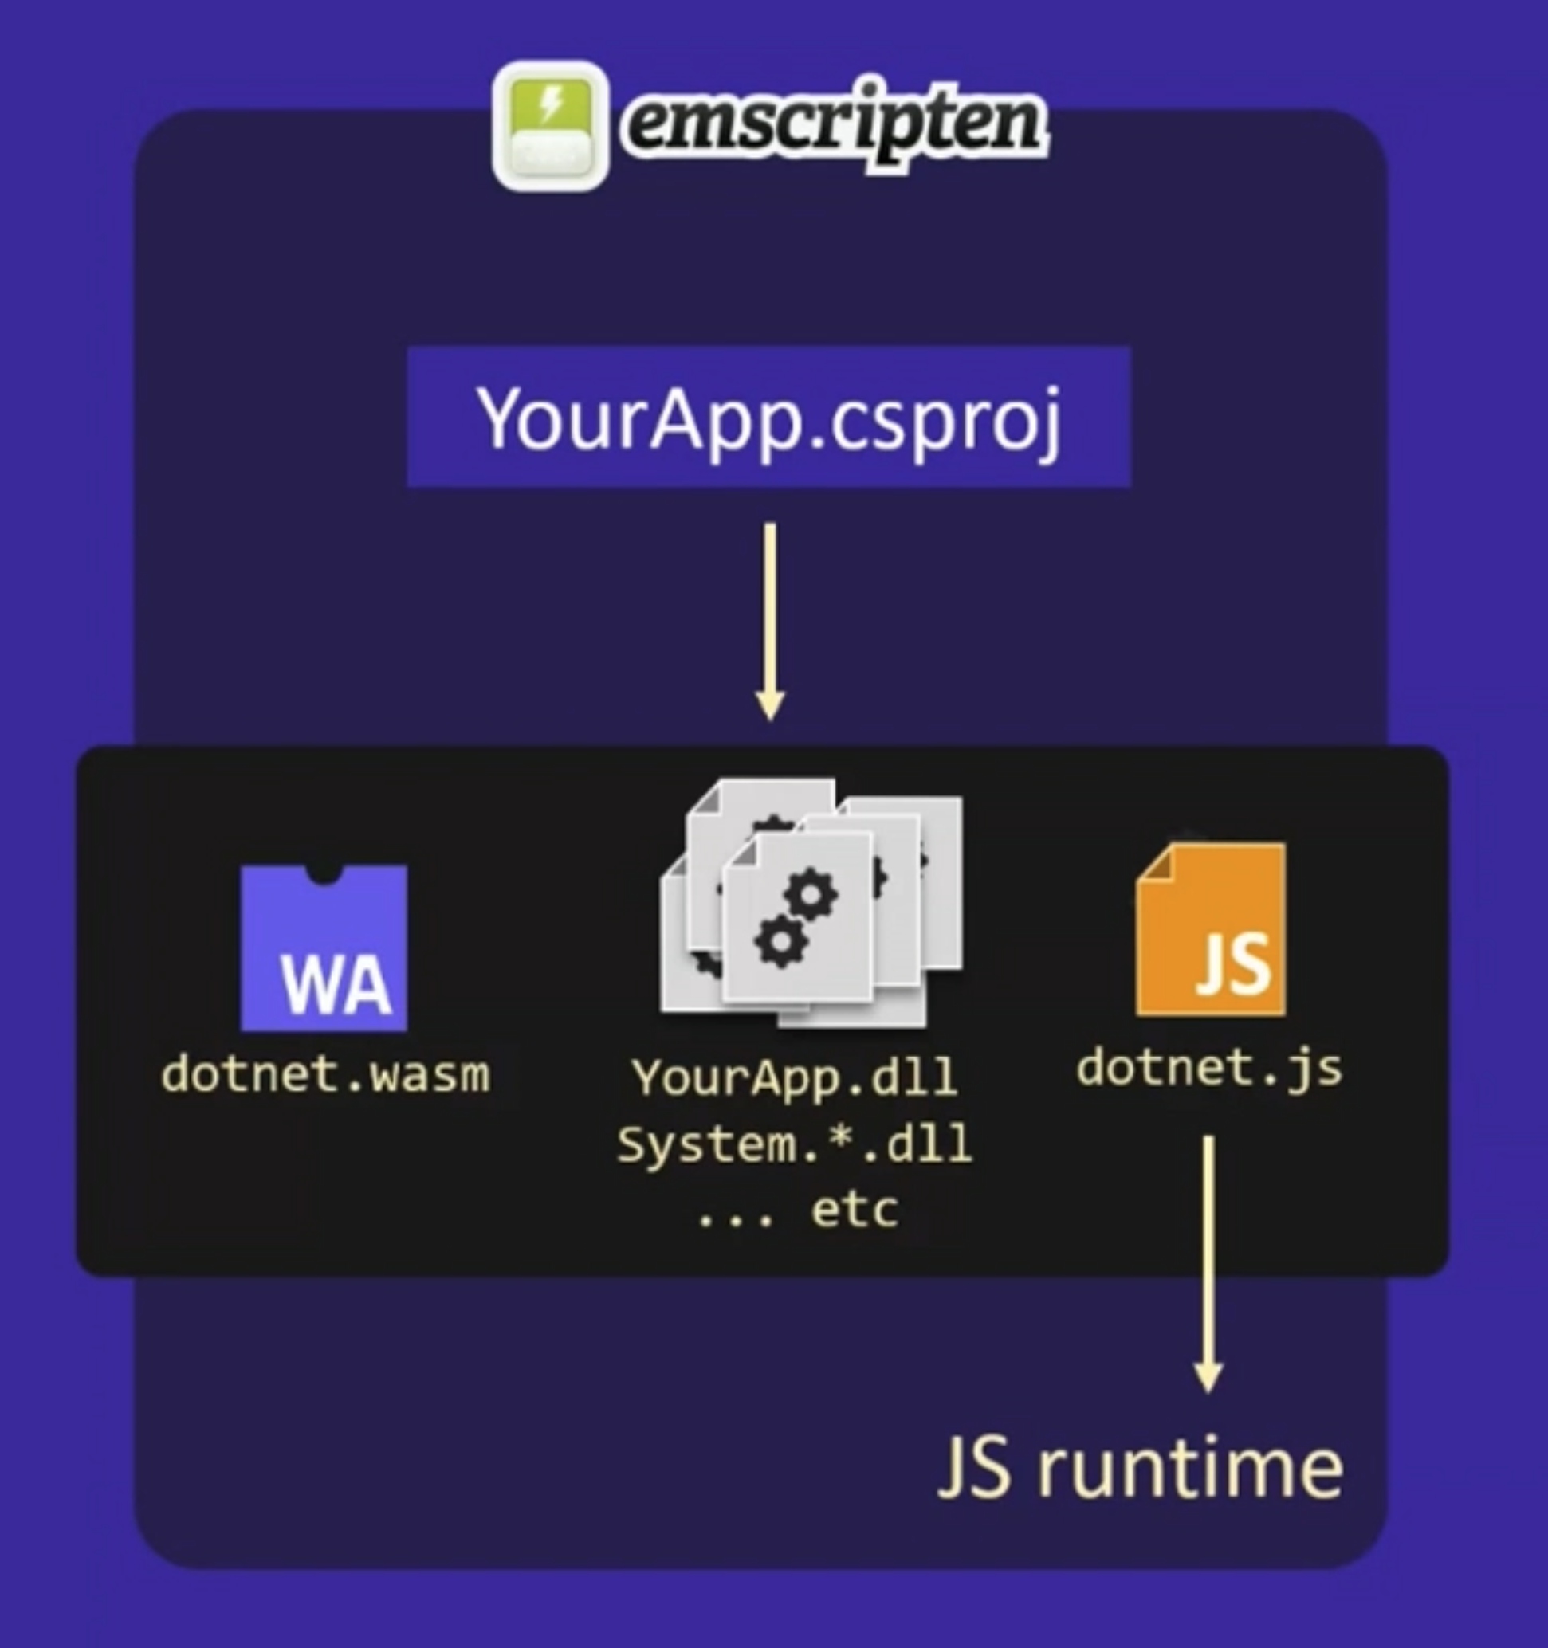
Blazor WebAssembly

Slide 34
Running .NET on WebAssembly
User code (IL)
User code (IL)
User code (IL)
Standard library (BCL)
Execution engine (VES)
Host (Browser)
Notes:
Diagram: https://github.com/itowlson/wasmday22/blob/main/slides/Wasm%20Interfaces%20and%20.NET.pptx

Slide 35
WebAssembly System Interface WASI
User code (IL)
User code (IL)
User code (IL)
User code (IL)
Standard library (BCL)
Execution engine (VES)
Host (WASI e.g. Wasmtime)

Slide 36
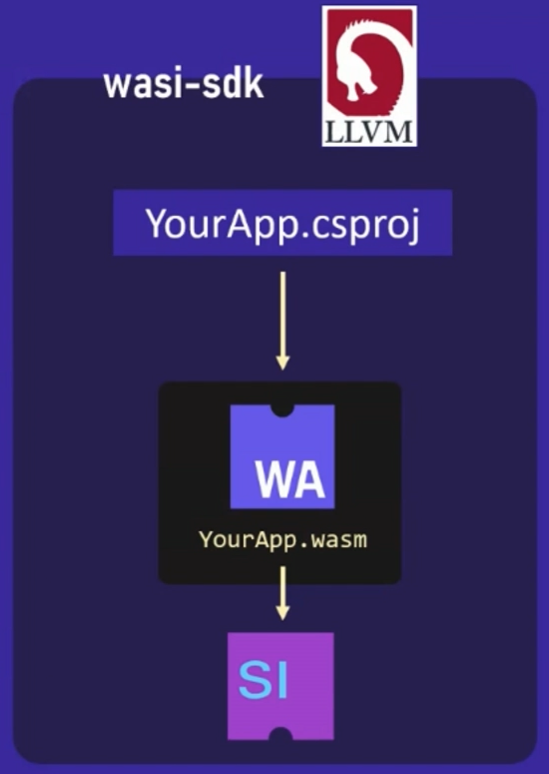
Demo WebAssembly Sandbox
Notes:
https://github.com/SteveSandersonMS/dotnet-wasi-sdk

Slide 37
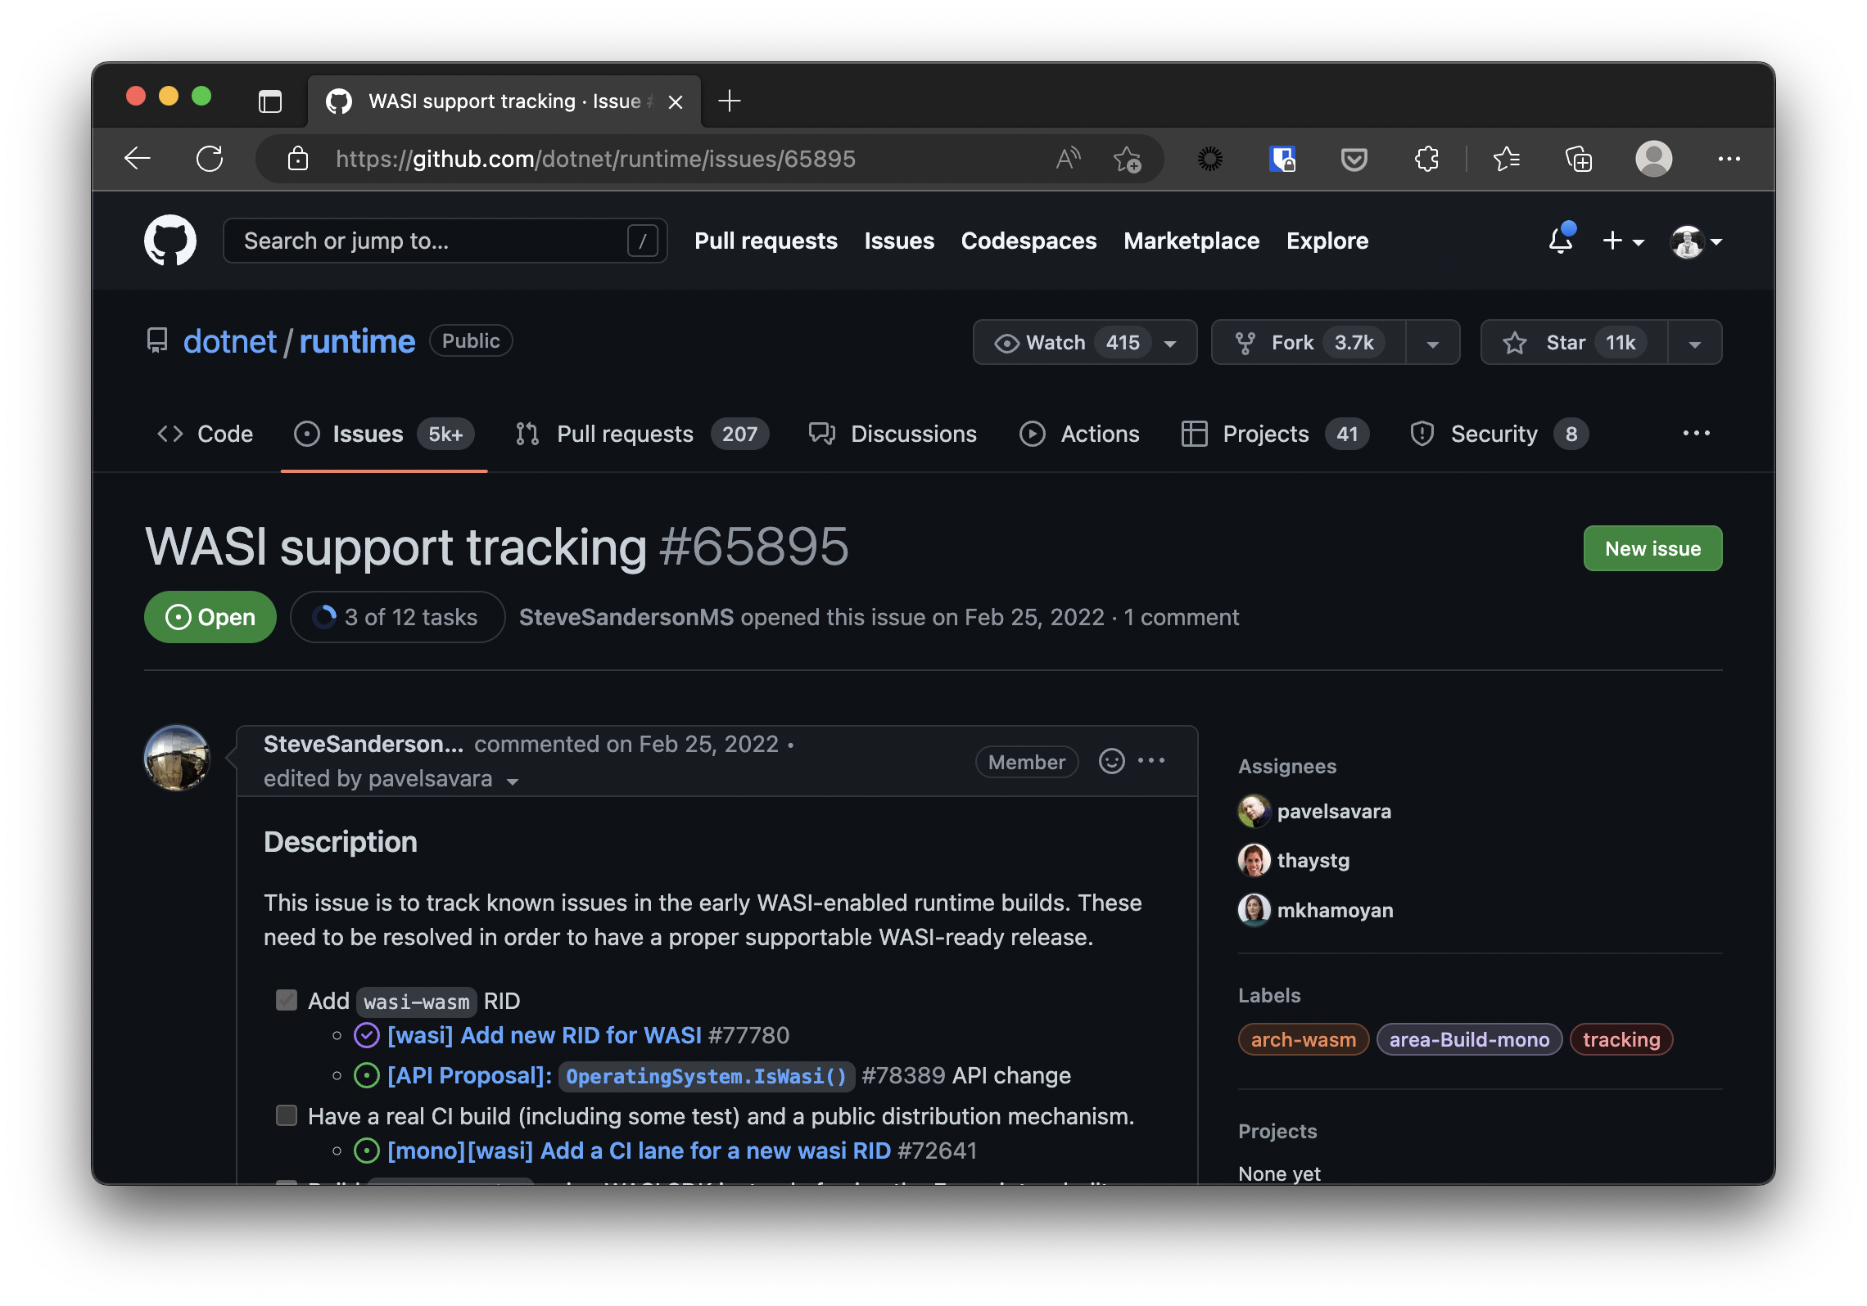
Experimental WASI SDK for .NET
Notes:
https://github.com/dotnet/runtime/issues/65895
https://github.com/SteveSandersonMS/dotnet-wasi-sdk

Slide 38
Conclusion
Update libraries; security problems get fixed
Integrate security into your development lifecycle
Know what libraries are used, where and what’s inside and most important what you’d expect from it.

Slide 39
Conclusion
Futures of this Sandbox Concept
Easier developer integration (e.g. source generator)
Package + good guidance on how this can be used in different application contexts like ASP.NET Core.
Basic patches/policy that can be applied on libraries
Using WebAssembly to run, extend, and secure your .NET Application talk (NDC Security 2023)

Slide 40
Thanks! Questions?
https://github.com/nielstanis/ndclondon2023-Sandbox ntanis at veracode.com
@nielstanis@infosec.exchange on Mastodon

